Slide 1


Photoresistor and LED
ELECTRICAL ENGINEERING AND COMPUTER SCIENCE, COLLEGE OF ENGINEERING AND PHYSICAL SCIENCES
Notes:
Updated 13 Jun 2024 by Noah Mulvaney

Slide 2
Goals
Introduce the photoresistor.
Demonstrate the basic functionality of the photoresistor.
Use the photoresistor to make an adaptive light dimmer.

Slide 3
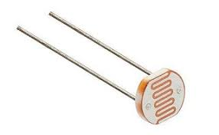
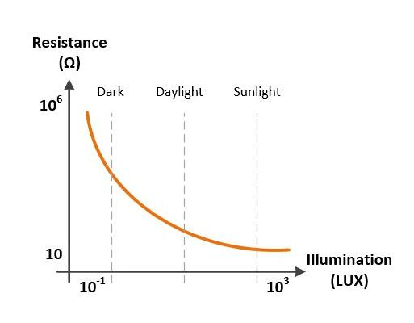
What is a Photoresistor
A photoresistor, also known as a light-dependent resistor (LDR) or a photo-conductive cell, decreases in resistance with increasing light intensity.
This functionality can be seen clearer when used in conjunction with an LED.
Notes:
https://commons.wikimedia.org/wiki/File:Sonar_Principle_EN.svg

Slide 4
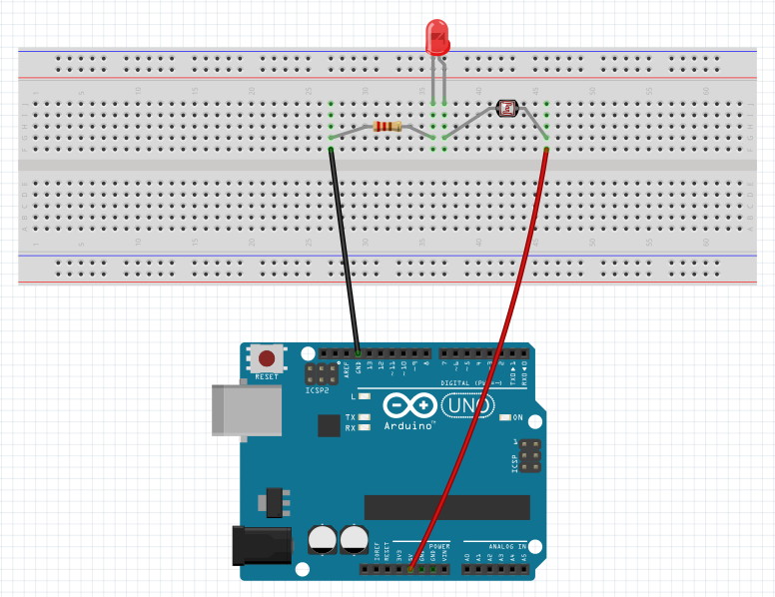
Demonstration
220 Ω Resistor
Make the following circuit and plug in your Arduino.
Use your hand to cover the photoresistor and observe how the LED brightness changes.
You don’t need to upload any code for this.
GND
5V
Notes:
https://commons.wikimedia.org/wiki/File:Sonar_Principle_EN.svg

Slide 5
What’s Next?
Now that the basic functionality of the photoresistor is understood. We will now use the photoresistor as a “sensor” for an adaptive dimmer switch.
This time if the photoresistor encounters more light, we want the LED to emit less light.
We will achieve this by utilizing the code in the following slides.
Notes:
https://commons.wikimedia.org/wiki/File:Sonar_Principle_EN.svg

Slide 6
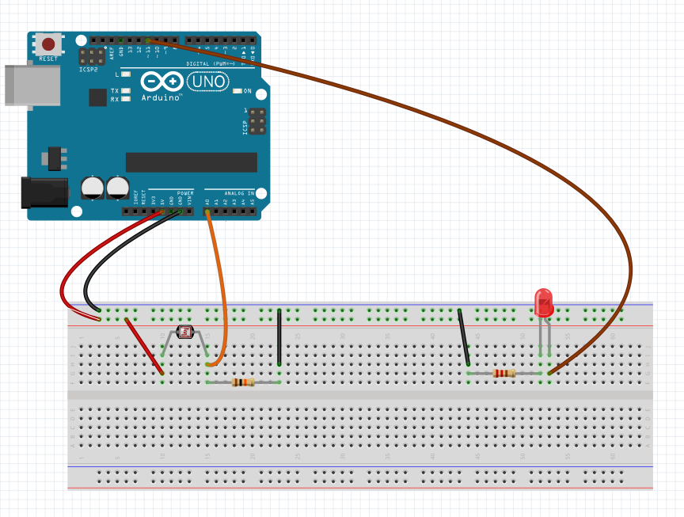
The Next Circuit Diagram
Pin 11
5V
GND
A0
10k Ω Resistor
220 Ω Resistor
Notes:
https://commons.wikimedia.org/wiki/File:Sonar_Principle_EN.svg

Slide 7
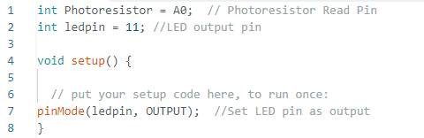

The Code
Open the Photoresistor_LED_Temp.ino File on the Arduino IDE
Notes:
https://commons.wikimedia.org/wiki/File:Sonar_Principle_EN.svg

Slide 8
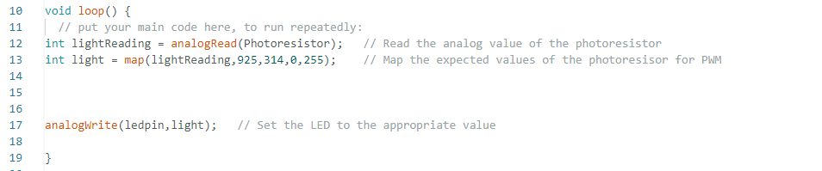
The Code
Notes:
https://commons.wikimedia.org/wiki/File:Sonar_Principle_EN.svg

Slide 9
Run The Program
The LED will now become brighter in the dark and will gradually turn off with more light exposure
Since each photoresistor is slightly different, you may need to adjust the code for better functionality
Tips for Troubleshooting are on the next Slide
Notes:
https://commons.wikimedia.org/wiki/File:Sonar_Principle_EN.svg

Slide 10
Troubleshooting
If the LED starts too bright and/or doesn’t adjust LED brightness well, adjust the first number by decreasing its value. Start with intervals of 25. This remaps the analog reading more accurately.
If LED dims with more light, but then switches to full brightness unexpectedly, increase the first number in intervals of 25. When the program receives a value outside of the mapped range, the LED receives full power. This works to prevent that.
Notes:
https://commons.wikimedia.org/wiki/File:Sonar_Principle_EN.svg

